Slide 1

What is a Hypothesis?
A hypothesis is a claim
(assumption) about a
population parameter:
  population mean
  population proportion
Example: The mean monthly cell phone bill of this city is μ = $42
Example: The proportion of adults in this city with cell phones is p = .68
Statistics for Business and Economics, 6e © 2007 Pearson Education, Inc.
Chap 10-<number>

Slide 2
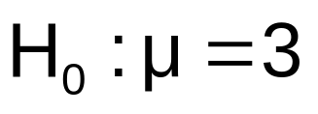

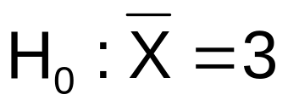
The Null Hypothesis, H₀
States the assumption (numerical) to be tested
  Example: The average number of TV sets in U.S. Homes is equal to three ( )
Is always about a population parameter, not about a sample statistic
Statistics for Business and Economics, 6e © 2007 Pearson Education, Inc.
Chap 10-<number>

Slide 3

The Null Hypothesis, H₀
(continued)
Begin with the assumption that the null hypothesis is true
  Similar to the notion of innocent until
  proven guilty
Refers to the status quo
Always contains “=” , “≤” or “≥” sign
May or may not be rejected
Statistics for Business and Economics, 6e © 2007 Pearson Education, Inc.
Chap 10-<number>

Slide 4
The Alternative Hypothesis, H₁
Is the opposite of the null hypothesis
  e.g., The average number of TV sets in U.S. homes is not equal to 3 ( H₁: μ ≠ 3 )
Challenges the status quo
Never contains the “=” , “≤” or “≥” sign
May or may not be supported
Is generally the hypothesis that the researcher is trying to support
Statistics for Business and Economics, 6e © 2007 Pearson Education, Inc.
Chap 10-<number>

Slide 5
Hypothesis Testing Process
Claim: the
population
mean age is 50.
(Null Hypothesis:
Population
H₀: μ = 50 )
Now select a random sample
X
Is
=
20
likely if μ = 50?
If not likely,
Suppose
the sample
REJECT
mean age
is 20: X = 20
Sample
Null Hypothesis
Statistics for Business and Economics, 6e © 2007 Pearson Education, Inc.

Slide 6
Reason for Rejecting H₀
Sampling Distribution of X
X
20
μ = 50
If H₀ is true
... then we reject the null hypothesis that μ = 50.
If it is unlikely that we would get a sample mean of this value ...
... if in fact this were
the population mean…
Statistics for Business and Economics, 6e © 2007 Pearson Education, Inc.
Chap 10-<number>

Slide 7
Level of Significance, α
Defines the unlikely values of the sample statistic if the null hypothesis is true
  Defines rejection region of the sampling distribution
Is designated by α , (level of significance)
  Typical values are .01, .05, or .10
Is selected by the researcher at the beginning
Provides the critical value(s) of the test
Statistics for Business and Economics, 6e © 2007 Pearson Education, Inc.
Chap 10-<number>

Slide 8
Level of Significance and the Rejection Region
Level of significance =
α
Represents
critical value
H₀: μ = 3 H₁: μ ≠ 3
α
α
/2
/2
Rejection region is shaded
Two-tail test
0
H₀: μ ≤ 3 H₁: μ > 3
α
Upper-tail test
0
H₀: μ ≥ 3 H₁: μ < 3
α
Lower-tail test
0
Statistics for Business and Economics, 6e © 2007 Pearson Education, Inc.
Chap 10-<number>

Slide 9
Errors in Making Decisions
Type I Error
  Reject a true null hypothesis
  Considered a serious type of error
  The probability of Type I Error is α
    Called level of significance of the test
    Set by researcher in advance
Statistics for Business and Economics, 6e © 2007 Pearson Education, Inc.
Chap 10-<number>

Slide 10
Errors in Making Decisions
(continued)
Type II Error
  Fail to reject a false null hypothesis
  The probability of Type II Error is β
Statistics for Business and Economics, 6e © 2007 Pearson Education, Inc.
Chap 10-<number>

Slide 11
Outcomes and Probabilities
Possible Hypothesis Test Outcomes
Actual Situation
Decision
H₀ True
H₀ False
Do Not
No error
(1 - )
Type II Error
( β )
Reject
Key:
Outcome
(Probability)
α
H
0
Reject
Type I Error
( )
No Error
( 1 - β )
H
α
0
Statistics for Business and Economics, 6e © 2007 Pearson Education, Inc.
Chap 10-<number>

Slide 12
Type I & II Error Relationship
Type I and Type II errors can not happen at
the same time
  Type I error can only occur if H₀ is true
  Type II error can only occur if H₀ is false
If Type I error probability ( α ) , then
Type II error probability ( β )
Statistics for Business and Economics, 6e © 2007 Pearson Education, Inc.
Chap 10-<number>

Slide 13
Factors Affecting Type II Error
All else equal,
  β when the difference between hypothesized parameter and its true value
  β when α
  β when σ
  β when n
Statistics for Business and Economics, 6e © 2007 Pearson Education, Inc.
Chap 10-<number>

Slide 14
Power of the Test
The power of a test is the probability of rejecting a null hypothesis that is false
i.e., Power = P(Reject H₀ | H₁ is true)
  Power of the test increases as the sample size increases
Statistics for Business and Economics, 6e © 2007 Pearson Education, Inc.
Chap 10-<number>

Slide 15
Hypothesis Tests for the Mean
Hypothesis
Tests for μ
σ Known
σ Unknown
Statistics for Business and Economics, 6e © 2007 Pearson Education, Inc.
Chap 10-<number>

Slide 16

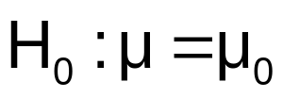
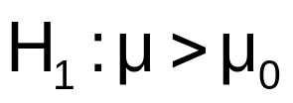
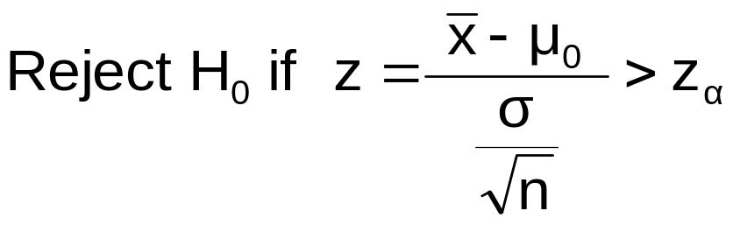
Test of Hypothesis for the Mean (σ Known)
Convert sample result ( ) to a z value
Hypothesis
Tests for μ
σ Known
σ Unknown
Consider the test
The decision rule is:
(Assume the population is normal)
Statistics for Business and Economics, 6e © 2007 Pearson Education, Inc.
Chap 10-<number>

Slide 17

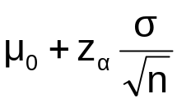
Decision Rule
H₀: μ = μ₀
H₁: μ > μ₀
Alternate rule:
α
Do not reject H₀
Reject H₀
Z
0
z_{α}
μ₀
Critical value
Statistics for Business and Economics, 6e © 2007 Pearson Education, Inc.
Chap 10-<number>

Slide 18
p-Value Approach to Testing
p-value: Probability of obtaining a test statistic more extreme ( ≤ or ≥ ) than the observed sample value given H₀ is true
  Also called observed level of significance
  Smallest value of α for which H₀ can be rejected
Statistics for Business and Economics, 6e © 2007 Pearson Education, Inc.
Chap 10-<number>

Slide 19
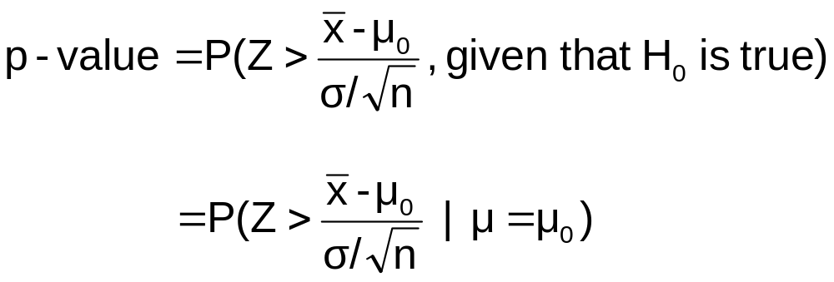
p-Value Approach to Testing
(continued)
Convert sample result (e.g., ) to test statistic (e.g., z statistic )
Obtain the p-value
  For an upper
  tail test:
Decision rule: compare the p-value to α
  If p-value < α , reject H₀
  If p-value ≥ α , do not reject H₀
Statistics for Business and Economics, 6e © 2007 Pearson Education, Inc.
Chap 10-<number>

Slide 20
Example: Upper-Tail Z Test for Mean (σ Known)
A phone industry manager thinks that customer monthly cell phone bill have increased, and now average over $52 per month. The company wishes to test this claim. (Assume σ = 10 is known)
Form hypothesis test:
H₀: μ ≤ 52 the average is not over $52 per month
H₁: μ > 52 the average is greater than $52 per month
(i.e., sufficient evidence exists to support the
manager’s claim)
Statistics for Business and Economics, 6e © 2007 Pearson Education, Inc.
Chap 10-<number>

Slide 21
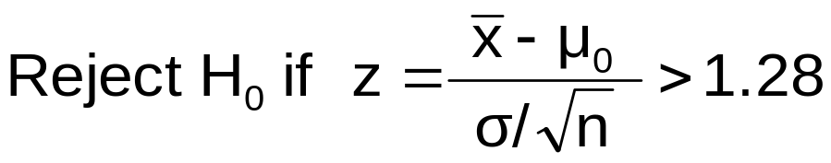
Example: Find Rejection Region
(continued)
Suppose that α = .10 is chosen for this test
Find the rejection region:
Reject H₀
α = .10
Do not reject H₀
Reject H₀
0
1.28
Statistics for Business and Economics, 6e © 2007 Pearson Education, Inc.
Chap 10-<number>

Slide 22
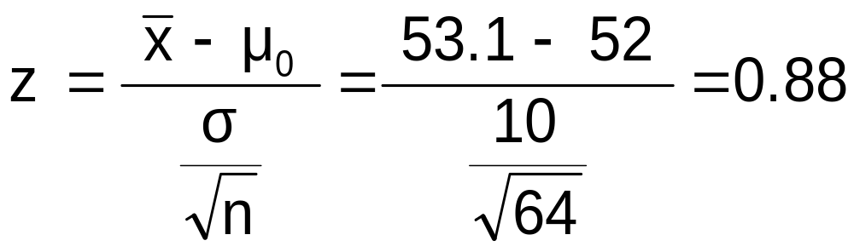
Example: Sample Results
(continued)
Obtain sample and compute the test statistic
Suppose a sample is taken with the following results: n = 64, x = 53.1 (σ=10 was assumed known)
  Using the sample results,
Statistics for Business and Economics, 6e © 2007 Pearson Education, Inc.
Chap 10-<number>

Slide 23
Example: Decision
(continued)
Reach a decision and interpret the result:
Reject H₀
α = .10
Do not reject H₀
1.28
Reject H₀
0
z = 0.88
Do not reject H₀ since z = 0.88 < 1.28
i.e.: there is not sufficient evidence that the
mean bill is over $52
Statistics for Business and Economics, 6e © 2007 Pearson Education, Inc.
Chap 10-<number>

Slide 24
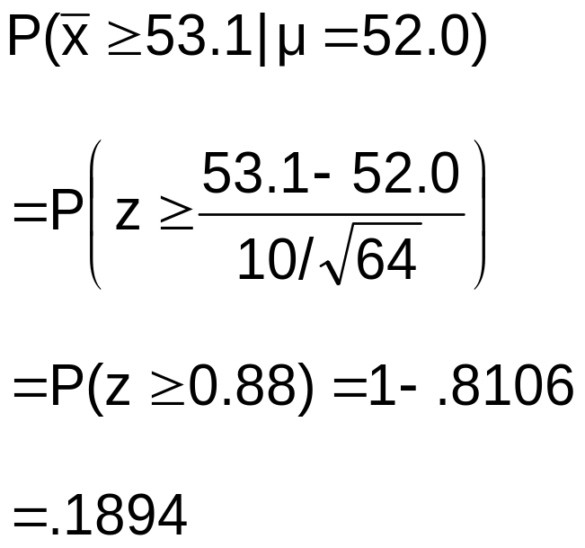
Example: p-Value Solution
(continued)
Calculate the p-value and compare to α
(assuming that μ = 52.0)
p-value = .1894
Reject H₀
α = .10
0
Do not reject H₀
1.28
Reject H₀
Z = .88
Do not reject H₀ since p-value = .1894 > α = .10
Statistics for Business and Economics, 6e © 2007 Pearson Education, Inc.
Chap 10-<number>

Slide 25
One-Tail Tests
In many cases, the alternative hypothesis focuses on one particular direction
H₀: μ ≤ 3
H₁: μ > 3
This is an upper-tail test since the alternative hypothesis is focused on the upper tail above the mean of 3
This is a lower-tail test since the alternative hypothesis is focused on the lower tail below the mean of 3
H₀: μ ≥ 3
H₁: μ < 3
Statistics for Business and Economics, 6e © 2007 Pearson Education, Inc.
Chap 10-<number>

Slide 26
Upper-Tail Tests
H₀: μ ≤ 3
H₁: μ > 3
There is only one critical value, since the rejection area is in only one tail
α
Do not reject H₀
Reject H₀
Z
0
z_{α}
μ
Critical value
Statistics for Business and Economics, 6e © 2007 Pearson Education, Inc.
Chap 10-<number>

Slide 27
Lower-Tail Tests
H₀: μ ≥ 3
H₁: μ < 3
There is only one critical value, since the rejection area is in only one tail
α
Reject H₀
Do not reject H₀
Z
-z_{α}
0
μ
Critical value
Statistics for Business and Economics, 6e © 2007 Pearson Education, Inc.
Chap 10-<number>

Slide 28
Two-Tail Tests
In some settings, the alternative hypothesis does not specify a unique direction
H₀: μ = 3 H₁: μ ≠ 3
α/2
α/2
There are two critical values, defining the two regions of rejection
x
3
Reject H₀
Do not reject H₀
Reject H₀
-z_{α/2}
0
+z_{α/2}
z
Lower critical value
Upper
critical value
Statistics for Business and Economics, 6e © 2007 Pearson Education, Inc.
Chap 10-<number>

Slide 29
Hypothesis Testing Example
Test the claim that the true mean # of TV sets in US homes is equal to 3.
(Assume σ = 0.8)
State the appropriate null and alternative
hypotheses
  H₀: μ = 3 , H₁: μ ≠ 3 (This is a two tailed test)
Specify the desired level of significance
  Suppose that α = .05 is chosen for this test
Choose a sample size
  Suppose a sample of size n = 100 is selected
Statistics for Business and Economics, 6e © 2007 Pearson Education, Inc.
Chap 10-<number>

Slide 30
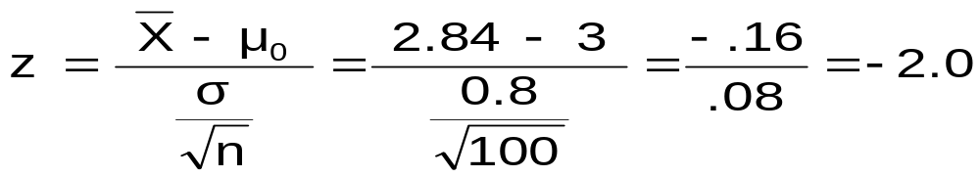
Hypothesis Testing Example
(continued)
Determine the appropriate technique
  σ is known so this is a z test
Set up the critical values
  For α = .05 the critical z values are ±1.96
Collect the data and compute the test statistic
  Suppose the sample results are
  n = 100, x = 2.84 (σ = 0.8 is assumed known)
  So the test statistic is:
Statistics for Business and Economics, 6e © 2007 Pearson Education, Inc.
Chap 10-<number>

Slide 31
Hypothesis Testing Example
(continued)
Is the test statistic in the rejection region?
Reject H₀ if z < -1.96 or z > 1.96; otherwise do not reject H₀
α = .05/2
α = .05/2
Reject H₀
Do not reject H₀
Reject H₀
-z = -1.96
0
+z = +1.96
Here, z = -2.0 < -1.96, so the test statistic is in the rejection region
Statistics for Business and Economics, 6e © 2007 Pearson Education, Inc.
Chap 10-<number>

Slide 32
Hypothesis Testing Example
(continued)
Reach a decision and interpret the result
α = .05/2
α = .05/2
Reject H₀
Do not reject H₀
Reject H₀
-z = -1.96
0
+z = +1.96
-2.0
Since z = -2.0 < -1.96, we reject the null hypothesis and conclude that there is sufficient evidence that the mean number of TVs in US homes is not equal to 3
Statistics for Business and Economics, 6e © 2007 Pearson Education, Inc.
Chap 10-<number>

Slide 33
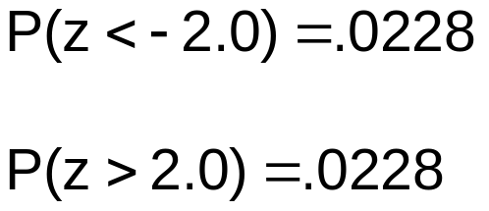
Example: p-Value
Example: How likely is it to see a sample mean of 2.84 (or something further from the mean, in either direction) if the true mean is μ = 3.0?
x = 2.84 is translated to a z score of z = -2.0
α/2 = .025
α/2 = .025
.0228
.0228
p-value
= .0228 + .0228 = .0456
-1.96
0
1.96
Z
-2.0
2.0
Statistics for Business and Economics, 6e © 2007 Pearson Education, Inc.
Chap 10-<number>

Slide 34
Example: p-Value
(continued)
Compare the p-value with α
  If p-value < α , reject H₀
  If p-value ≥ α , do not reject H₀
Here: p-value = .0456
α = .05
Since .0456 < .05, we reject the null hypothesis
α/2 = .025
α/2 = .025
.0228
.0228
-1.96
0
1.96
Z
-2.0
2.0
Statistics for Business and Economics, 6e © 2007 Pearson Education, Inc.
Chap 10-<number>

Slide 35
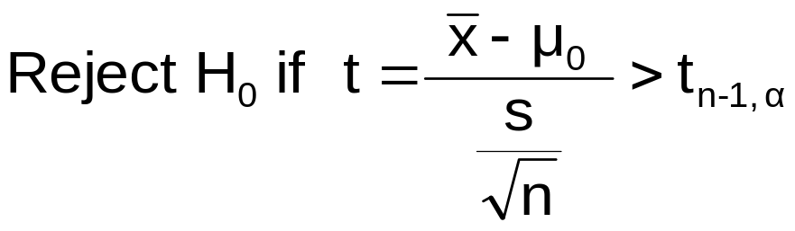
t Test of Hypothesis for the Mean (σ Unknown)
Convert sample result ( ) to a t test statistic
Hypothesis
Tests for μ
σ Known
σ Unknown
Consider the test
The decision rule is:
(Assume the population is normal)
Statistics for Business and Economics, 6e © 2007 Pearson Education, Inc.
Chap 10-<number>

Slide 36
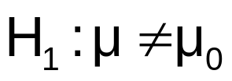
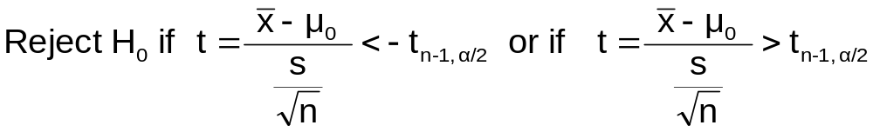
t Test of Hypothesis for the Mean (σ Unknown)
(continued)
For a two-tailed test:
Consider the test
(Assume the population is normal, and the population variance is unknown)
The decision rule is:
Statistics for Business and Economics, 6e © 2007 Pearson Education, Inc.
Chap 10-<number>

Slide 37

Example: Two-Tail Test
(σ Unknown)
The average cost of a hotel room in New York is said to be $168 per night. A random sample of 25 hotels resulted in x = $172.50 and
s = $15.40. Test at the
α = 0.05 level.
(Assume the population distribution is normal)
H₀: μ = 168 H₁: μ ≠ 168
Statistics for Business and Economics, 6e © 2007 Pearson Education, Inc.
Chap 10-<number>

Slide 38
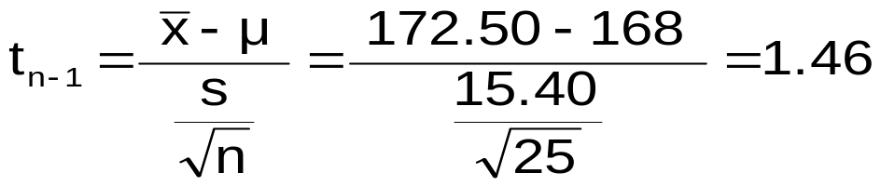
Example Solution:
Two-Tail Test
H₀: μ = 168 H₁: μ ≠ 168
α/2=.025
α/2=.025
α = 0.05
n = 25
σ is unknown, so
use a t statistic
Critical Value:
t_{24 , .025} = ± 2.0639
Reject H₀
Do not reject H₀
Reject H₀
-t _{n-1,α/2}
t _{n-1,α/2}
0
-2.0639
2.0639
1.46
Do not reject H₀: not sufficient evidence that true mean cost is different than $168
Statistics for Business and Economics, 6e © 2007 Pearson Education, Inc.
Chap 10-<number>

Slide 39
Tests of the Population Proportion
Involves categorical variables
Two possible outcomes
  “Success” (a certain characteristic is present)
  “Failure” (the characteristic is not present)
Fraction or proportion of the population in the “success” category is denoted by P
Assume sample size is large
Statistics for Business and Economics, 6e © 2007 Pearson Education, Inc.
Chap 10-<number>

Slide 40

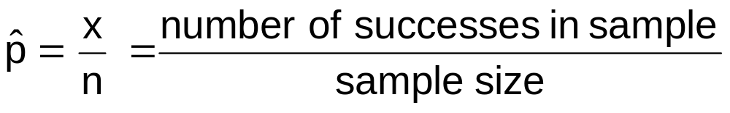
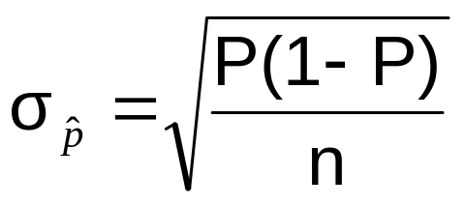
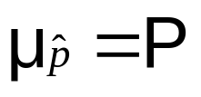
Proportions
(continued)
Sample proportion in the success category is denoted by
When nP(1 – P) > 9, can be approximated by a normal distribution with mean and standard deviation
Statistics for Business and Economics, 6e © 2007 Pearson Education, Inc.
Chap 10-<number>

Slide 41
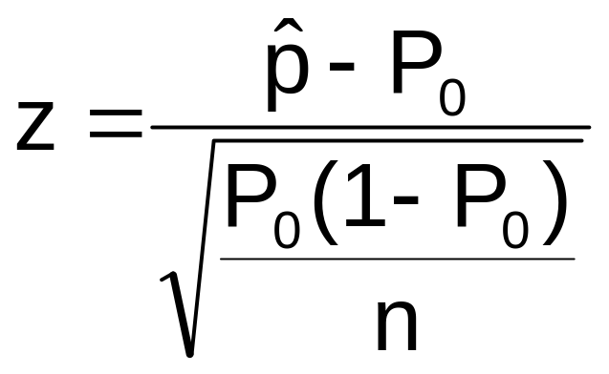
Hypothesis Tests for Proportions
The sampling distribution of is approximately normal, so the test statistic is a z value:
Hypothesis
Tests for P
nP(1 – P) > 9
nP(1 – P) < 9
Not discussed in this chapter
Statistics for Business and Economics, 6e © 2007 Pearson Education, Inc.
Chap 10-<number>

Slide 42

Example: Z Test for Proportion
A marketing company claims that it receives 8% responses from its mailing. To test this claim, a random sample of 500 were surveyed with 25 responses. Test at the α = .05 significance level.
Check:
Our approximation for P is
= 25/500 = .05
nP(1 - P) = (500)(.05)(.95)
= 23.75 > 9
✓
Statistics for Business and Economics, 6e © 2007 Pearson Education, Inc.
Chap 10-<number>

Slide 43
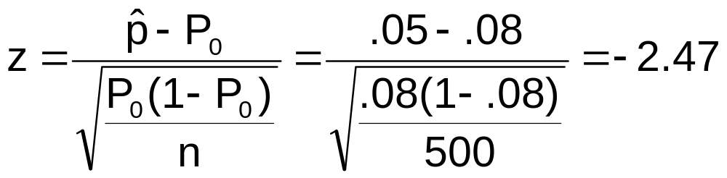
Z Test for Proportion: Solution
Test Statistic:
H₀: P = .08 H₁: P ≠ .08
α = .05
n = 500, = .05
Critical Values: ± 1.96
Decision:
Reject H₀ at α = .05
Reject
Reject
Conclusion:
.025
.025
There is sufficient evidence to reject the company’s claim of 8% response rate.
z
-1.96
0
1.96
-2.47
Statistics for Business and Economics, 6e © 2007 Pearson Education, Inc.
Chap 10-<number>

Slide 44
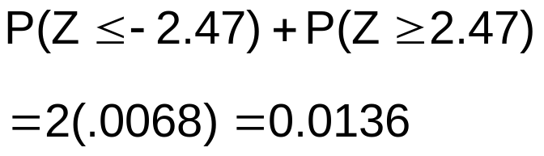
p-Value Solution
(continued)
Calculate the p-value and compare to α
(For a two sided test the p-value is always two sided)
Do not reject H₀
Reject H₀
Reject H₀
p-value = .0136:
α/2 = .025
α/2 = .025
.0068
.0068
-1.96
0
1.96
Z = -2.47
Z = 2.47
Reject H₀ since p-value = .0136 < α = .05
Statistics for Business and Economics, 6e © 2007 Pearson Education, Inc.
Chap 10-<number>

Slide 45
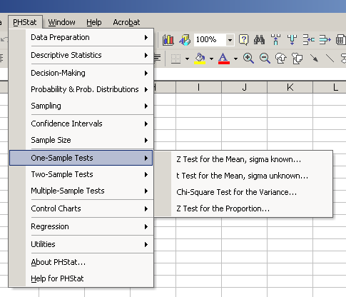
Using PHStat
Options
Statistics for Business and Economics, 6e © 2007 Pearson Education, Inc.
Chap 10-<number>

Slide 46
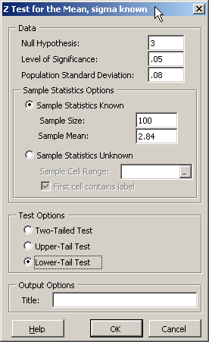
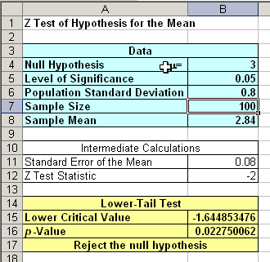
Sample PHStat Output
Input
Output
Statistics for Business and Economics, 6e © 2007 Pearson Education, Inc.
Chap 10-<number>

Slide 47
Power of the Test
Recall the possible hypothesis test outcomes:
Actual Situation
Decision
H₀ True
H₀ False
Key:
Outcome
(Probability)
Do Not
Reject H₀
No error
(1 - )
Type II Error
( β )
α
Reject H₀
Type I Error
( )
No Error
( 1 - β )
α
β denotes the probability of Type II Error
1 – β is defined as the power of the test
Power = 1 – β = the probability that a false null
hypothesis is rejected
Statistics for Business and Economics, 6e © 2007 Pearson Education, Inc.
Chap 10-<number>

Slide 48


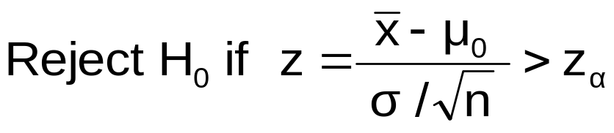
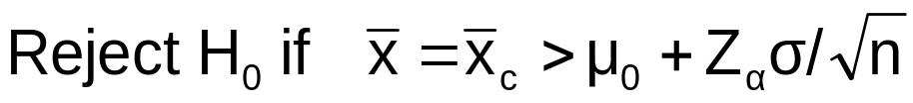
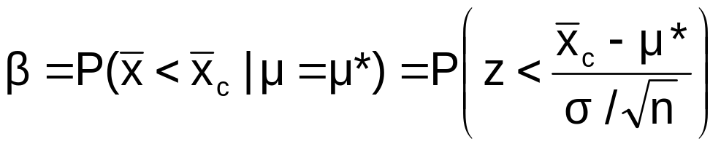
Type II Error
Assume the population is normal and the population variance is known. Consider the test
The decision rule is:
or
If the null hypothesis is false and the true mean is μ*, then the probability of type II error is
Statistics for Business and Economics, 6e © 2007 Pearson Education, Inc.
Chap 10-<number>

Slide 49


Type II Error Example
Type II error is the probability of failing to reject a false H₀
Suppose we fail to reject H₀: μ ≥ 52
when in fact the true mean is μ* = 50
α
50
52
Reject
H₀: μ ≥ 52
Do not reject
H₀ : μ ≥ 52
Statistics for Business and Economics, 6e © 2007 Pearson Education, Inc.
Chap 10-<number>

Slide 50
Type II Error Example
(continued)
Suppose we do not reject H₀: μ ≥ 52 when in fact the true mean is μ* = 50
This is the range of x where H₀ is not rejected
This is the true distribution of x if μ = 50
50
52
Reject
H₀: μ ≥ 52
Do not reject
H₀ : μ ≥ 52
Statistics for Business and Economics, 6e © 2007 Pearson Education, Inc.
Chap 10-<number>

Slide 51

Type II Error Example
(continued)
Suppose we do not reject H₀: μ ≥ 52 when in fact the true mean is μ* = 50
Here, β = P( x ≥ ) if μ* = 50
α
β
50
52
Reject
H₀: μ ≥ 52
Do not reject
H₀ : μ ≥ 52
Statistics for Business and Economics, 6e © 2007 Pearson Education, Inc.
Chap 10-<number>

Slide 52
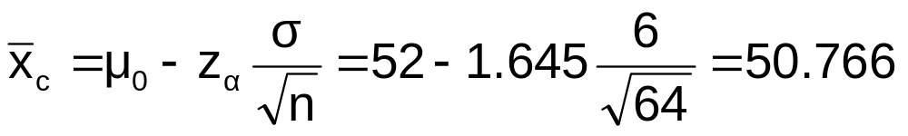
Calculating β
Suppose n = 64 , σ = 6 , and α = .05
(for H₀ : μ ≥ 52)
So β = P( x ≥ 50.766 ) if μ* = 50
α
50
50.766
52
Reject
H₀: μ ≥ 52
Do not reject
H₀ : μ ≥ 52
Statistics for Business and Economics, 6e © 2007 Pearson Education, Inc.
Chap 10-<number>

Slide 53
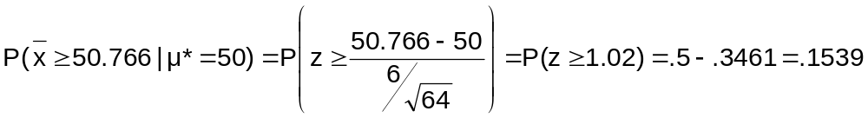
Calculating β
(continued)
Suppose n = 64 , σ = 6 , and α = .05
Probability of type II error:
β = .1539
α
50
52
Reject
H₀: μ ≥ 52
Do not reject
H₀ : μ ≥ 52
Statistics for Business and Economics, 6e © 2007 Pearson Education, Inc.
Chap 10-<number>

Slide 54
Power of the Test Example
If the true mean is μ* = 50,
The probability of Type II Error = β = 0.1539
The power of the test = 1 – β = 1 – 0.1539 = 0.8461
Actual Situation
Decision
H₀ True
H₀ False
Key:
Outcome
(Probability)
Do Not
Reject H₀
No error
1 - α = 0.95
Type II Error
β = 0.1539
Reject H₀
Type I Error
α = 0.05
No Error
1 - β = 0.8461
(The value of β and the power will be different for each μ*)
Statistics for Business and Economics, 6e © 2007 Pearson Education, Inc.
Chap 10-<number>

Slide 55
Chapter Summary
Addressed hypothesis testing methodology
Performed Z Test for the mean (σ known)
Discussed critical value and p-value approaches to hypothesis testing
Performed one-tail and two-tail tests
Performed t test for the mean (σ unknown)
Performed Z test for the proportion
Discussed type II error and power of the test
Statistics for Business and Economics, 6e © 2007 Pearson Education, Inc.
Chap 10-<number>

